Slide 1
Heart Disease Detection: A simple yet effective ML practice.
20101074_Sarika Bintey Sabur
20101040_Jawad Bin Alam
20101383_Abdullah Saeed
23341135_MD. Abdullah Al Sadik
23341136_Samia Semu

Slide 2
Introduction
Heart disease is a leading global cause of death.
Machine learning offers efficient prediction by analyzing risk factors and patterns.
Our project aims to develop an accurate ML-based prediction model using comprehensive health data.
The model can enhance patient care by identifying high-risk individuals.
Growing demand exists for ML-driven predictive modeling in healthcare due to electronic health records.
Our work covers data processing, risk factor analysis, model training, and performance metrics.
Outcomes could significantly impact clinical practice and public health strategies.

Slide 3
Literature Review
Using decision tree for diagnosing heart disease patients | Proceedings of the Ninth Australasian Data Mining Conference - Volume 121
Heart Disease Prediction Using Supervised Machine Learning Algorithms
Prediction of Coronary Heart Disease using Machine Learning: An Experimental Analysis
Efficient Heart Disease Prediction System using K-Nearest Neighbor Classification Technique | Proceedings of the International Conference on Big Data and Internet of Thing

Slide 4
Methodology
Methodologies we have used in this project -
Dataset Description: Source from UCI Machine Learning Repository and Kaggle, 14 attributes selected for analysis among 76 available attributes.
Data Pre-processing: Handling null values, encoding categorical features, feature scaling, dataset splitting.
Model Training & Testing: KNN, Decision Tree, SVM, Logistic Regression algorithms used for heart disease prediction.
Model Selection/Comparison Analysis: Evaluation based on accuracy, precision, recall, and F1 score metrics.

Slide 5
Dataset Analysis
Data Collection: The origin of the data Cleveland database from UCI Machine Learning Repository, later downloaded in a formatted way from Kaggle. Total 1028 data points.
Correlation Analysis: Explored relationships between risk factors and heart disease through statistical analysis.
Data Distribution: Examined the distribution of quantitative and categorical data points in the dataset.
Data Pre-processing: Handled null values, encoded categorical features, performed feature scaling, and split the dataset for analysis.
Data Splitting: Used 70% data for training and 30% data for testing.

Slide 6
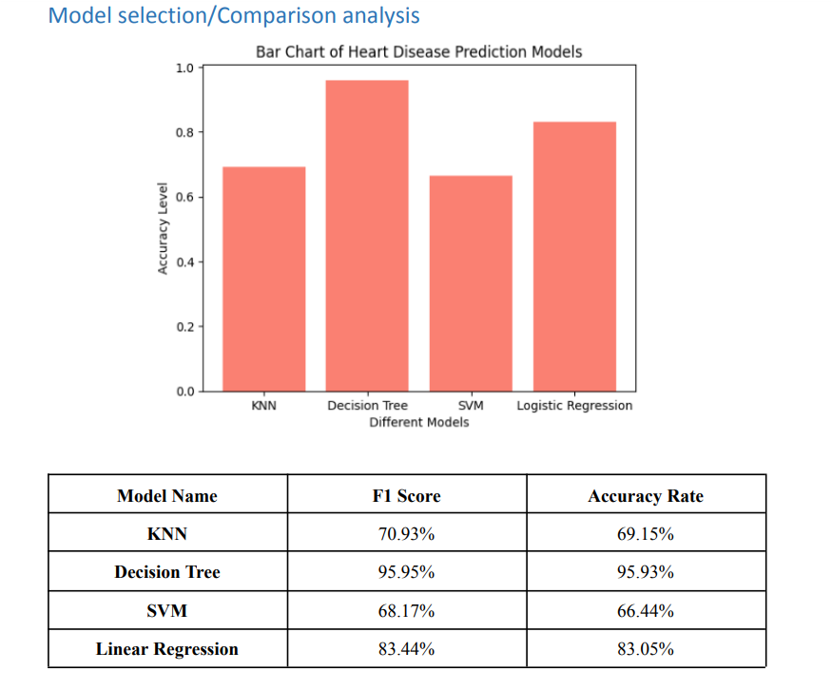
Outcome

Slide 7
Conclusion
ML models accurately predict heart disease risk.
Valuable insights for early detection and intervention.
Significant implications for healthcare practitioners, researchers, and policymakers.
Assist in identifying high-risk individuals for preventive measures.
Contribute to research on ML in healthcare and heart disease prediction.
Further research needed for validation and refinement of models.

Slide 8

g
f

